Slide 1
Welcome Back!

Slide 2
Our Agenda
What is STLs
Vectors

Slide 3

Vectors
We have assumed that our needed capacity is 1000 and stored info in an array of 1000. But now after expansion, they need more space!
Vectors are built-in and already do this!
Solutions?
Create an array with a larger
Space and copy the information to it
Who has time for this?

Slide 4
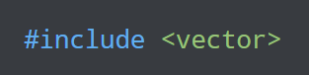
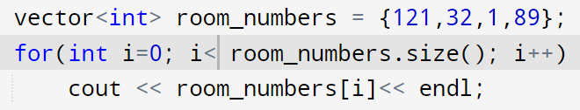
Vectors
size of a vector can grow dynamically
Grows at runtime, we can expand the size
throughout the code

Slide 5
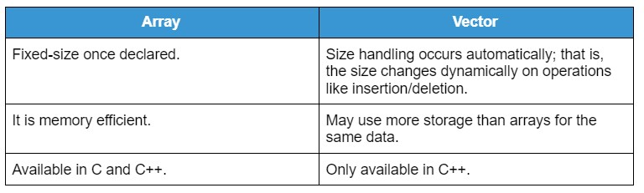
Vectors VS array

Slide 6
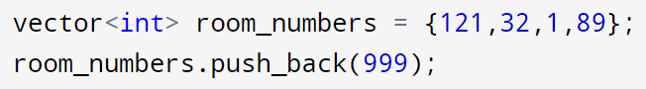
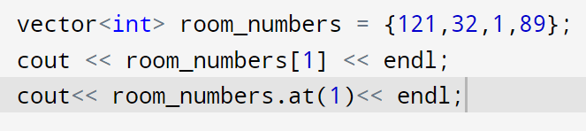
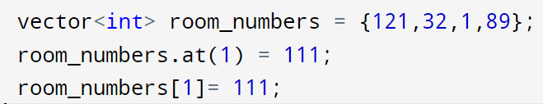
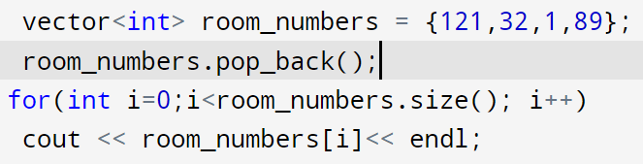
Important methods in vector
Add elements
Access elements
Change elements
Remove elements
What is the difference?

Slide 7
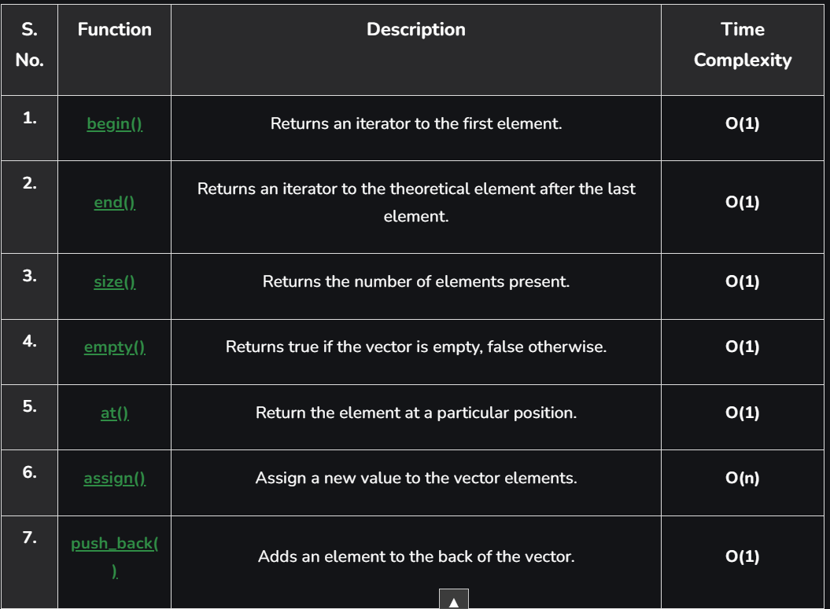
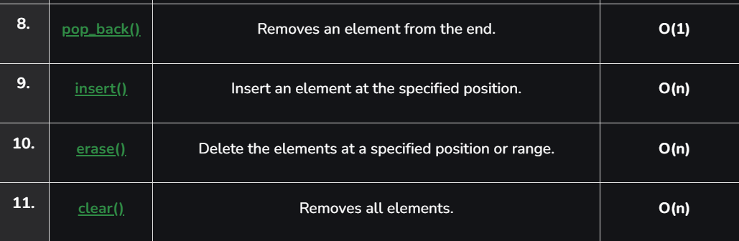

Slide 8
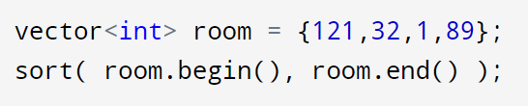
Sort and reverse vector
Sorting

Slide 9
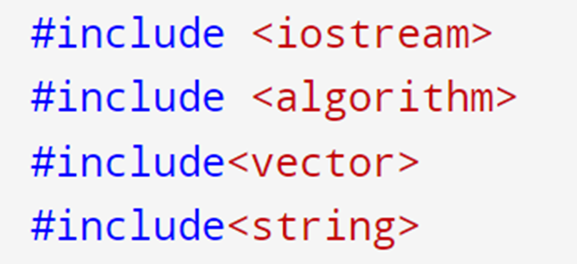
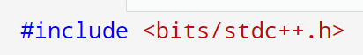
.
.
.
.
.

Slide 10
vector<bool> boolVec = {true, false, true};
cout << "Size: " << boolVec.size() << endl;
cout << "Max Size: " << boolVec.max_size() << endl;
cout << "First Element: " << boolVec.front() << endl;
cout << "Last Element: " << boolVec.back() << endl;
boolVec.push_back(false);
cout << "After Pushing Back, Size: " << boolVec.size() << endl;
boolVec.pop_back();
cout << "After Popping Back, Size: " << boolVec.size() << endl;
vector<int> vec = {1, 2, 3, 4, 5};
vec.resize(8, 10);
cout << "Resized vector with default value:" <<endl;
for (int num : vec) {
cout << num << " ";
}
cout <<endl;
vec.resize(3);
cout << "Resized vector without default value:" << endl;
for (int num : vec) {
cout << num << " ";
}
cout <<endl;
vector<int> vec1 = {1, 8, 5};
vector<int> vec2 = {4, 5, 6};
vec1.swap(vec2);
for (int num : vec2) {
cout << num << " ";
}
vec2.assign({1, 2, 3});
for (int num : vec2) {
cout << num << " ";
}

Slide 11
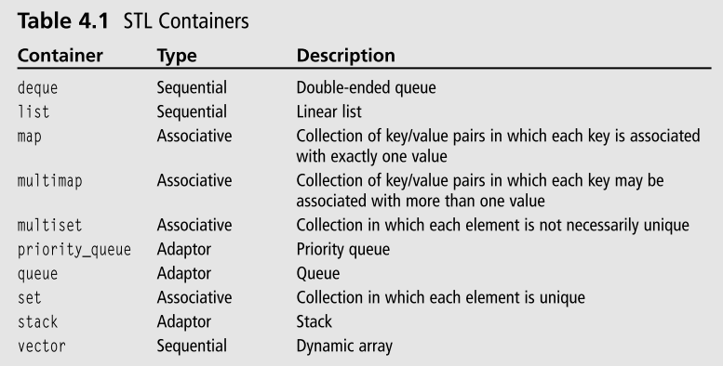
What is STLs ?
The C++ STL (Standard Template Library) is a powerful set of C++ template classes to provide general-purpose classes and functions with templates that implement many popular and commonly used algorithms and data structures like vectors, lists, queues, and stacks.

Slide 12

Solving Time

Slide 13


Thank you for your time! # yarab tdkholo elganna

